Slide 1
Image Analysis and quantification

Slide 2
Image-Processing Lab
2 classes: 1 lecture +demo on segmentation(today), troubleshooting with Tas (Dec 1). Reports are due December 10. (10% per day late submission)
Somewhat more exploratory and open-ended don’t expect to work 100% for all images – do the best you can, There is no 100% right solution, guiding questions/hints instead of well-defined assignment.

Slide 3
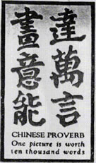
Images are key to all areas of bioengineering research
Picture is worth 10000 words
But… is it worth 10000 numbers???
Science must be quantifiable and results must be numerical, should be able to use statistics!

Slide 4
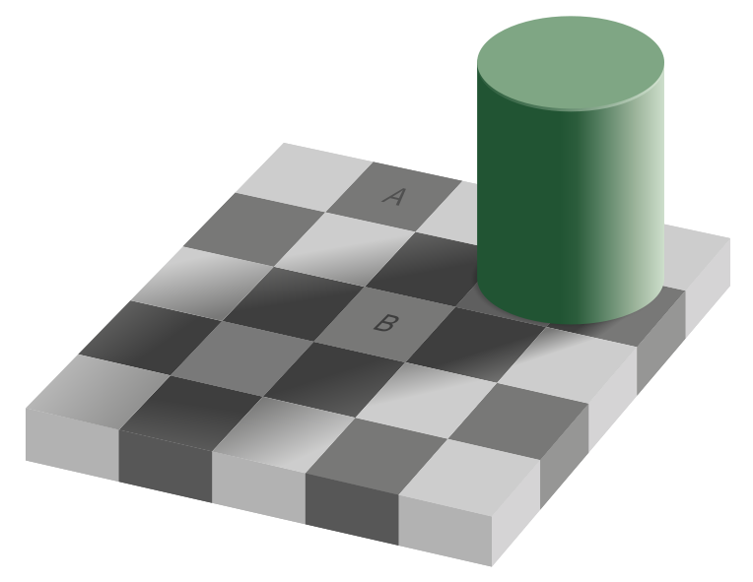
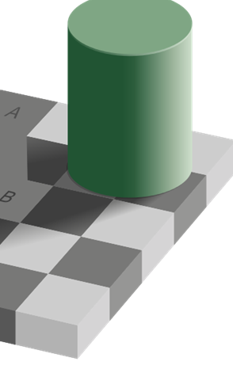
Don’t trust your eyes!

Slide 5
http://www.pasteur.gr/wp-content/uploads/Basics-of-Quantitative-image-analysis.pdf

Slide 6
http://www.pasteur.gr/wp-content/uploads/Basics-of-Quantitative-image-analysis.pdf

Slide 7
What can be quantified?

Slide 8
Commonly used terms
Meijering and van Cappellen

Slide 9
Image Processing tools
We will be focusing on MATLAB Image processing toolbox
Other big Players – ImageJ (Fuji), CellProfiler
All of the above constrain some GUI-based tools but the best use is via programing/scripting

Slide 10
MATLAB Image Processing Toolbox Dos and Don'ts
Do read help on every command and some background to understand the logic behind algorithm
Do check how changing input parameters affect the results
Do use the MathWorks extensive help system, search engines, community blog and MATLAB Central code exchange portals
Don’t try to invent your own algorithms (unless everything else fails)
Don’t settle for the default parameters without understanding what these mean

Slide 11
Images in MATLAB
MATLAB can import/export several image formats
BMP (Microsoft Windows Bitmap)
GIF (Graphics Interchange Files)
HDF (Hierarchical Data Format)
JPEG (Joint Photographic Experts Group)
PCX (Paintbrush)
PNG (Portable Network Graphics)
TIFF (Tagged Image File Format)
XWD (X Window Dump)
MATLAB can also load raw-data or other types of image data
Data types in MATLAB
Double (64-bit double-precision floating point)
Single (32-bit single-precision floating point)
Int32 (32-bit signed integer)
Int16 (16-bit signed integer)
Int8 (8-bit signed integer)
Uint32 (32-bit unsigned integer)
Uint16 (16-bit unsigned integer)
Uint8 (8-bit unsigned integer)

Slide 12
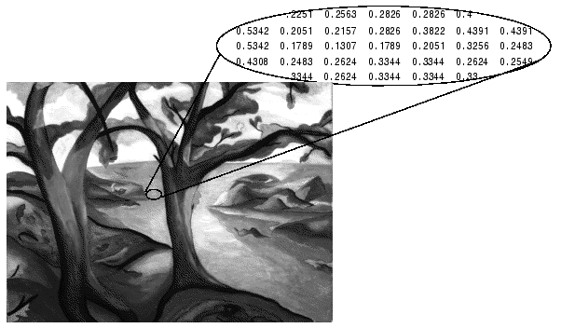
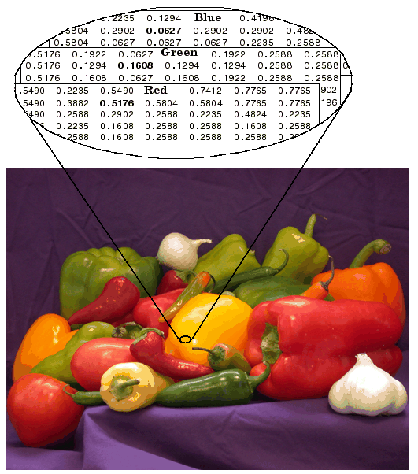
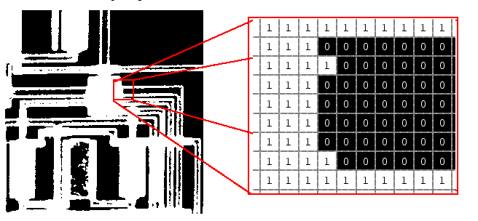
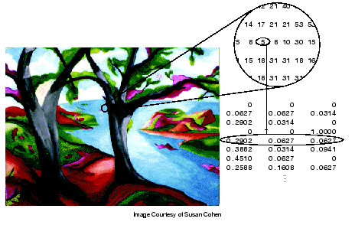
Images in MATLAB
• Binary images : {0,1}
• Intensity images : binary [0 or 1] or uint8 or uint8, double (from 0 to 1)
• RGB images : m-by-n-by-3

Slide 13
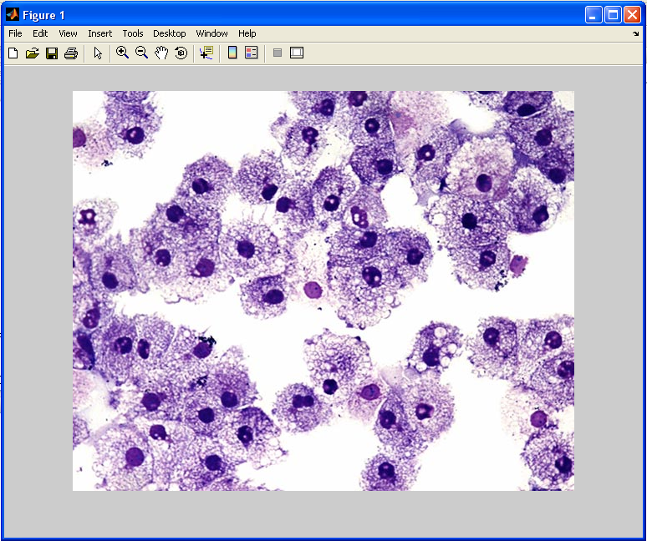
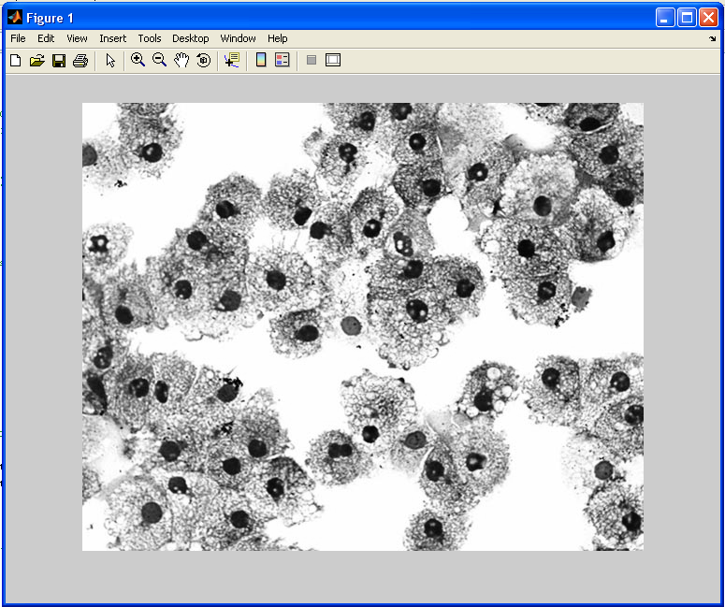
Image import and export
Read and write images in Matlab
>> I=imread('cells.jpg');
>> imshow(I)
>> size(I)
ans = 479 600 3 (RGB image)
>> Igrey=rgb2gray(I);
>> imshow(Igrey)
>> imwrite(lgrey, 'cell_gray.tif', 'tiff')
Alternatives to imshow
>>imagesc(I)
>>imtool(I)
>>image(I)
To save an image:

Slide 14
Coordinate convention
RiCe – R before C, row index first!

Slide 15
Image types
Image Type | Interpretation
Binary (Also known as a bilevel image) | Logical array containing only 0s and 1s, interpreted as black and white, respectively. See Binary Images for more information.
Indexed (Also known as a pseudocolor image) | Array of class logical, uint8, uint16, single, or double whose pixel values are direct indices into a colormap. The colormap is an m-by-3 array of class double. For single or double arrays, integer values range from [1, p]. For logical, uint8, or uint16 arrays, values range from [0, p-1]. See Indexed Images for more information.
Grayscale (Also known as an intensity, gray scale, or gray level image) | Array of class uint8, uint16, int16, single, or double whose pixel values specify intensity values. For single or double arrays, values range from [0, 1]. For uint8, values range from [0,255]. For uint16, values range from [0, 65535]. For int16, values range from [-32768, 32767]. See Grayscale Imagesfor more information.
Truecolor (Also known as an RGB image ) | m-by-n-by-3 array of class uint8, uint16, single, or double whose pixel values specify intensity values. For single or double arrays, values range from [0, 1]. For uint8, values range from [0, 255]. For uint16, values range from [0, 65535]. See Truecolor Images for more information.
See for details Matlab help: https://www.mathworks.com/help/images/image-types-in-the-toolbox.html
Given that most bio-image processing deals with color-channels independently we can focus on greyscale

Slide 16
Gray-scale Images
Matrix values in uint8 integers (2^8: 0-255 values)
Matrix values in uint16 integers (2^16: 0-65535 values)
Matrix values double scaled from 0 to 1
Matrix values 0 or 1 (binary images)

Slide 17
Toolbox functions for conversion
Beware of the range for each when doing manipulations:
1+1=10 in binary

Slide 18
Here and below some examples come from:
Some excerpts will be posted on canvas.

Slide 19
Type of image transformation
Contrast/intensity adjustment
M*[i,j]=F(M*[i,j]) : the same function is applied all the pixel
Geometric transformation
E.g., image shifts, stitching, rotations, stretching, resampling
Local Image Filtering:
M*[i,j]=F(∑M*[I’,j’]) pixel value affected by some neighboring points
Image restoration:
E.g., background subtraction, noise reduction, deconvolution

Slide 20
Contrast/intensity adjustment
Meijering and van Cappellen
imadjust
multithresh
imbinarize
histeq
adapthisteq

Slide 21
Contrast/intensity adjustment
Can be good for visualization and as a step of quantification procedure, e.g. segmentation
Be careful - can lead to information loss
Matlab
>>imadjust(f, [low_in high_in], [low_out high_out], gamma)

Slide 23
Geometric transformations

Slide 24
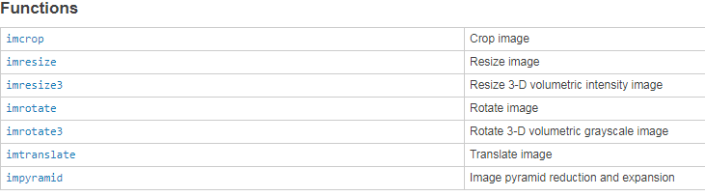
Matlab common geometric transformations

Slide 25
Spatial Filtering
Idea – let’s weight-average the nearby pixels
More-generally we can have weights that do not add up to 1 or negative, for example to take derivatives
Can be thought as “convolution”

Slide 26
Sample filtering problem
Imagine that due to weak labeling, short exposure time (e.g. to avoid over exposure in other mart of the image) you have a region in which few photons are detected by each pixel
As a result Poisson noise (1/sqrt(N)). For N~10 or more Gaussian is a recent approximation
Filtering can help to reduce this noise
Simplest filter – Mean Filter: The value of a pixel is replaced by the intensity mean of the neighborhood pixels.
3x3 example
http://www.pasteur.gr/wp-content/uploads/Basics-of-Quantitative-image-analysis.pdf

Slide 27
http://www.pasteur.gr/wp-content/uploads/Basics-of-Quantitative-image-analysis.pdf

Slide 28
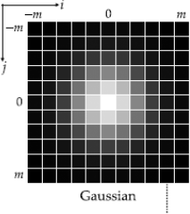
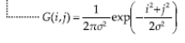
http://www.pasteur.gr/wp-content/uploads/Basics-of-Quantitative-image-analysis.pdf

Slide 29
-Completely eliminates outliers
-Edge-preserving
-Non-linear and therefore irreversible
http://www.pasteur.gr/wp-content/uploads/Basics-of-Quantitative-image-analysis.pdf

Slide 30
http://www.pasteur.gr/wp-content/uploads/Basics-of-Quantitative-image-analysis.pdf

Slide 31
Fourier Transform Filters
FT of the image is reversible
Sometimes filtering in FT makes a better filter when reversed, e.g. periodic noise
http://www.pasteur.gr/wp-content/uploads/Basics-of-Quantitative-image-analysis.pdf

Slide 32
Filtering and morphological transformations
When working with segmented images it is often helpful to move the boundaries, e.g. dilute or erode the segmented objects
Special filters are in MATLAB toolbox that do just that:
https://www.mathworks.com/help/images/morphological-filtering.html

Slide 33
Useful morphological transformations
imdialate
imerode
imclose
imopen
edge
bwmorph
Meijering and van Cappellen

Slide 34
Image segmentation basics

Slide 36
The simplest way: thresholding
Histogram is bimodal, so put
threshold in the trough between
the peaks!
multithresh
imbinarize
>>imbinarize(I, 'adaptive');

Slide 37
After segmentation
Using the knowledge of the topology of the segmented objects you can use morphological transformations to improve the results
label with different numbers with bwlabel
Plenty of tools to quantify properties of the segmented objects (in binary mask and original image):
regionprops | Measure properties of image regions

Slide 38
Another way to segment – edge detection

Slide 40
Idea: use derivatives

Slide 41
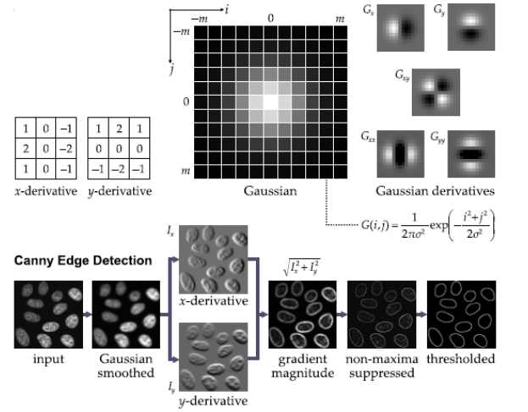
Canny edge detector
>> edge(I,'Canny')

Slide 42
Separating merged objects: watershed

Slide 43
Compute distance to the boundary with bwdist
See watershed command in Matlab

